Slide 1

SOCIAL MEDIA ANALYTICS PLATFORM
Understanding User Behavior and Trends
19/11/2024
MEMBERS
Vivian Ndung’u – 1049495
Zuena Kiplagat – 1049086
Abigail Kagoiza – 1052096
Abigail Kirimi – 1049507
Beatrice Wamboi – 1052049

Slide 2
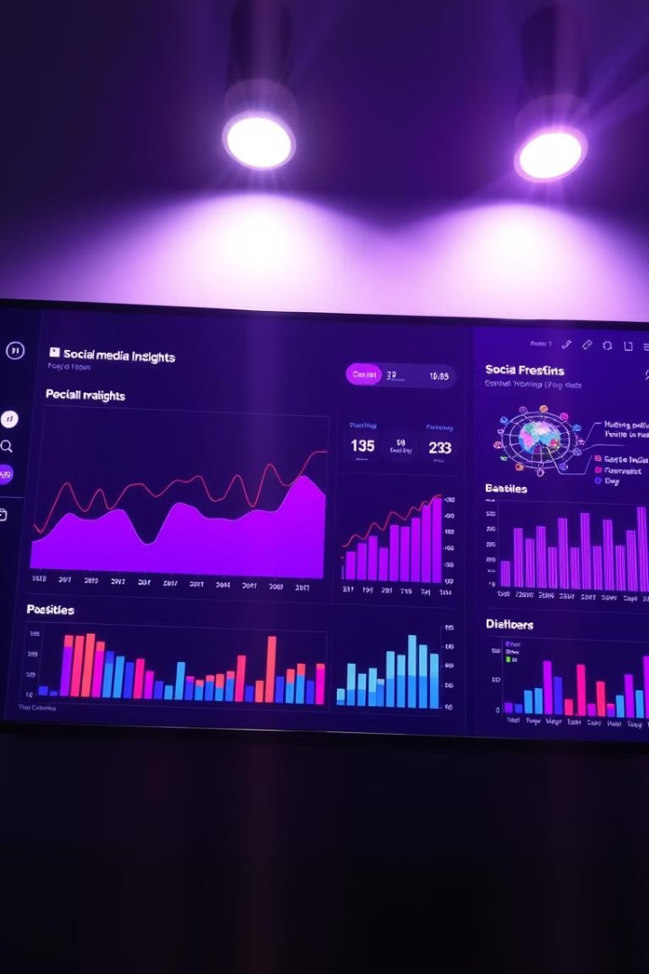
Social Media Analytics Platform
This presentation outlines the design and functionality of our Social Media Analytics Platform (SMAP) - a powerful tool for unlocking valuable insights from user behavior and social media trends.

Slide 3
Overview and Rationale
Overview
Rationale
SMAP aggregates, analyzes, and visualizes social media data to provide insights into user behavior, trending topics, and sentiment analysis.
The platform addresses the growing need for actionable insights to drive marketing strategies, product development, and customer engagement in the ever-expanding social media landscape.

Slide 4

Key Objectives
Data Extraction
Data Analytics
User Interface
Efficiently extract data from various social media platforms (e.g., Twitter, Instagram, Facebook).
Perform data analytics and generate reports on user engagement, sentiment, and trends.
Provide a user-friendly interface for querying and visualizing data.

Slide 5
System Architecture
High-Level Architecture
Technologies
The architecture includes data sources, storage, processing, and visualization components.
Databases: PostgreSQL (structured) and MongoDB (unstructured). Web Server: Node.js. Application Server: Express.js. Front-End: React.js.

Slide 6
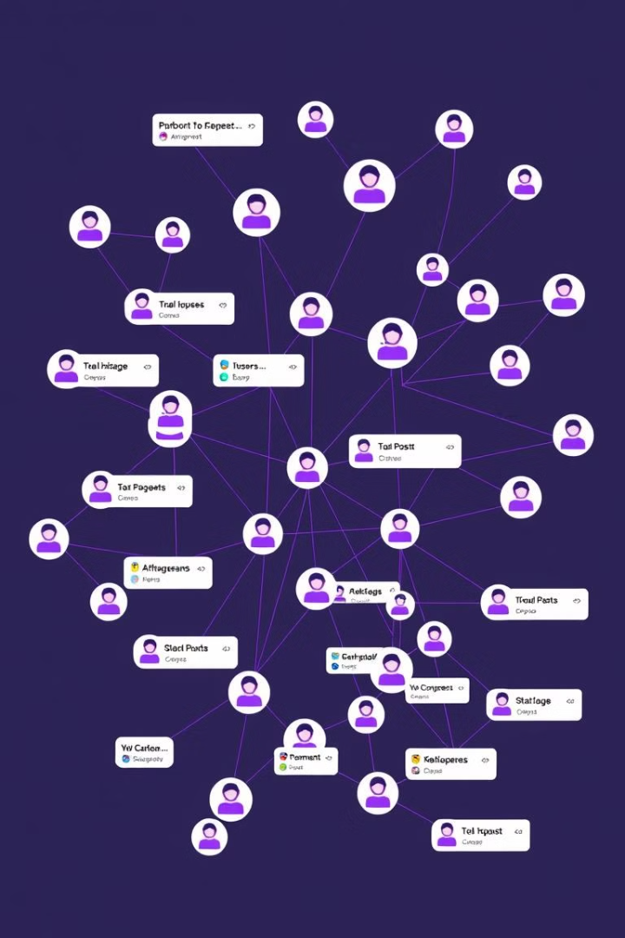
Database Design
Table Structures
The database includes tables for Posts, Users, Sentiments, Topics, Interactions, and Comments.
ERD
The ERD visualizes the relationships between entities like Users, Posts, Comments, Likes, Trends, and Metrics.
Data Flow Diagram (DFD)
The DFD showcases the flow of data through the system, from API calls to data ingestion, storage, and visualization.

Slide 7
CRUD Operations
Create
Read
Update
Delete
Add new data to the database using the INSERT statement. Example: Adding a new post.
Retrieve data from the database using the SELECT statement. Example: Retrieving all posts by a specific user.
Modify existing data in the database using the UPDATE statement. Example: Updating the like count for a specific post.
Remove data from the database using the DELETE statement. Example: Removing a post.

Slide 8

Key SQL Operations
1
Data Extraction
Extract data from the database based on specific criteria. Example: Select posts from a specific date range.
2
Data Transformation
Transform data to create new insights. Example: Calculate the total posts for each user.
3
Data Loading
Load data into the database. Example: Insert a new user into the Users table.
4
Data Analysis
Analyze data to uncover patterns and insights. Example: Calculate the average engagement rate for technology posts.

Slide 9
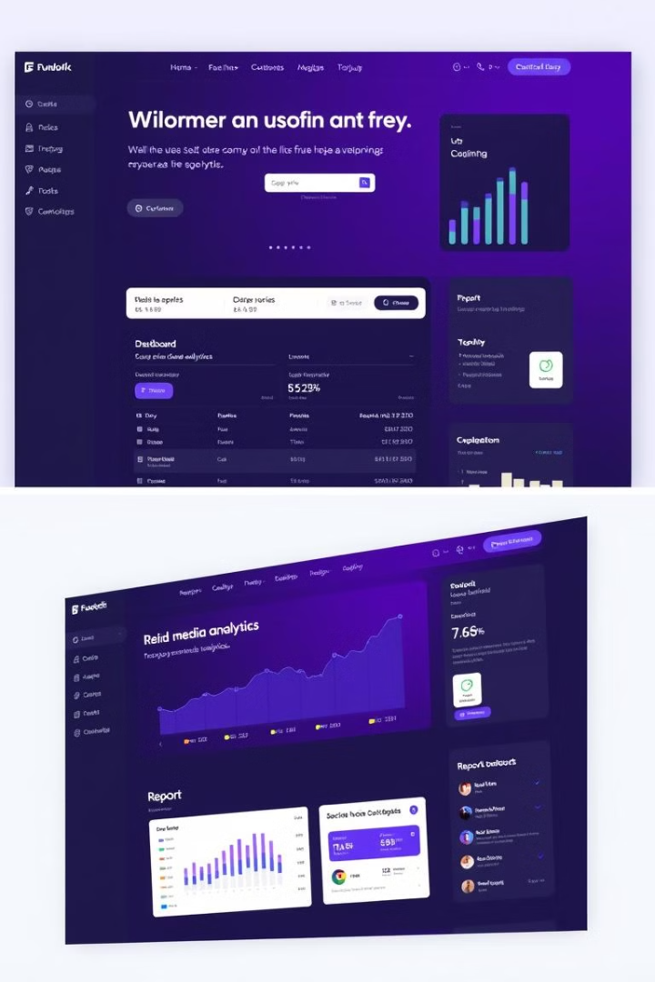




Demonstration and User Guide
Login
Enter your credentials (username and password) on the login page.
Dashboard
View key metrics like total posts, followers, engagement rate, and top-performing posts.
Data Exploration
Search, filter, and sort data to explore insights.
Report Generation
Create custom or pre-built reports, and export them in various formats.

Slide 10





Recommendations and Future Enhancements
Sentiment Analysis
1
Analyze sentiment for comments and posts to understand user opinions.
2
Real-Time Analytics
Enable real-time data processing for monitoring engagement metrics.
3
Advanced User Segmentation
Segment users based on demographics, activity level, and interests.
4
Predictive Analytics
Predict engagement trends for specific users and identify the best time to post.
Integration with Other Social Platforms
5
Expand data import capabilities to include Twitter, Instagram, and other social media platforms.

Slide 11

Conclusion
The Social Media Analytics Platform provides a robust framework for capturing, analyzing, and visualizing social media data. By leveraging this platform, organizations can gain valuable insights into user behavior, trends, and sentiment, empowering data-driven decision-making and ultimately enhancing their social media presence.

